Slide 1
Review of previous classes
1. Nanotechnology in upward motion: next future of science and technology is nanotechnology
2. Constructive - Destructive interference by thin films
3. Non-Reflective Surfaces
4. Super-Hydro-Phobicity
5. Self-Cleaning
6. History
7. Why <100nm
Why Surface to Volume Ratio
Magic Number

Slide 2

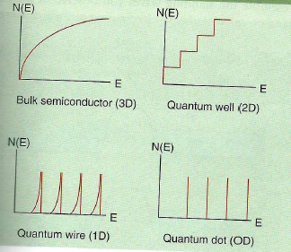
Dr. Manoranjan Kar (mano@iitp.ac.in), Indian Institute of Technology Patna, www.iitp.ac.in
QUANTUM EFFECT
Quantum mechanics is a branch of physics that was developed in the early part of the 20th century. It is extremely effective in describing the behaviour of atoms, molecules, nuclei and most recently “NANOPARTICLE”
It consider all particle are wave….
One way to look the wave function is to consider particles as stationary waves.
Density of states: It is a physical property of a material that indicates the structure and degree of packing of energy levels in a quantum mechanical system.

Slide 3
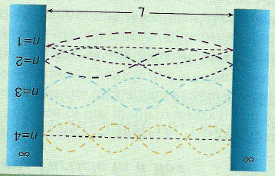
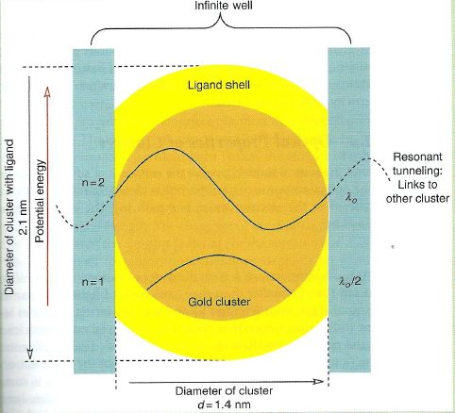
Dr. Manoranjan Kar (mano@iitp.ac.in), Indian Institute of Technology Patna, www.iitp.ac.in
Particle in a BOX
Example: Consider an atom
L = 0.1nm E₃=338.4ev, λ=4.12nm
Butadene: CH₂=C-C-CH₂
C-C=1.54Å
C=C->1.35Å
L = 5.78Å
n=1 is full and n=2 is full so transition from 2-3
E_{n3}-E_{n2}=9.02x10⁻¹⁹J
λ=220nm
Experimental observation 217nm.

Slide 4



SYMMETRY BREAKING
Three aspects of the problem of symmetry breaking
(1) The relation of the physical properties of the samples to their dimensionality (samples with quasi-zero dimension (0D), unidimensional (1D), bidimensional (2D) or tridimensional (3D)).
(2) The change in coordination of the atoms at the interface.
(3) The effect of the increase in the proportion of surface (or interface) atoms in nanoscopic samples.
DENSITY OF ELECTRONIC STATES AND DIMENSIONALITY
potential V(x,y, z) inside the box of side L is V₀ =const
for 0 ≤ x ≤ L, 0 ≤ y ≤ L, and 0 ≤ z ≤ L; V = ∞
Use

Slide 5
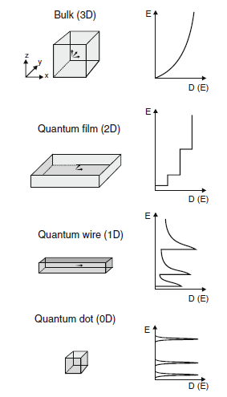

Slide 6






From the boundary condition, one can get
Ψ = 0 for x = 0, x = L, y=0, y = L, z = 0, z = L
Number of states N is,
At T = 0, all states are occupied upto K_{F} (Fermi wave vector)

Slide 7




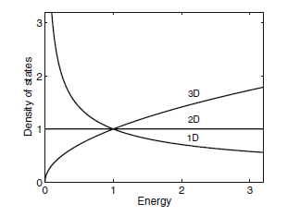

Slide 8







Slide 9
The Fermi Energy, Fermi Velocity and Kubo Gap
Density of States: Density of states in the metal per unit volume per unit energy
K-space: having a radius k, volume is
Sphere has a constant energy surface and also contains many states with smaller energies with smaller characteristic by smaller radii.
The volume of a given state in k-space is simple the product, V_{stat}=k_{x}k_{y}k_{z}, where k_{x}=2π/L_{x}, k_{y}=2π/L_{y} and k_{z}=2π/L_{z}.
Number of energy states N₁ contain within the sphere ,
Since electron posses two spin orientations that are equal in energy,
So N₂=2N₁.

Slide 10
Number per unit volume per unit energy
Total concentration of carrier, n in the metal
F(E) is called the Fermi-Dirac distribution. E_{F} is the fermi energy and represents the energy where f(E_{F}) = ½ at 0K
The Fermi Energy of Copper: Z=29, density of bulk copper= 8.96g/cm³, Atomic mass = 63.55g/ml. ρ = 1.41x10⁵mol/m³, equivalent atomic density = 8.49x10²⁸atom/m³.
Each copper atom contributes 1 electron to the solid. So, electron density is
n(0K)=8.49x10²⁸electrons/m³
E_{F}=1.126x10⁻²⁶J=7.03eV
Fermi Velocity: E = ½ mv2, V_{F}=2E_{F}(0K)/m=1.57x10⁶m/s
Fermi Wavelength: λ_{F}=0.46nm

Slide 11
Review of previous classes
1. Nanotechnology in upward motion: next future of science and technology is nanotechnology
2. Constructive - Destructive interference by thin films
3. Non-Reflective Surfaces
4. Super-Hydro-Phobicity
5. Self-Cleaning
6. History
7. Why <100nm
8. Magic Number
9- Confinement in Semiconductor
10-Magnetic nanoparticles
11- Why Surface to Volume Ratio
12- Magic Number
HOW TO GENERATE NANOMATERIALS

Slide 12
Assignment
Write a computer programming to deduce the total number of atoms and surface atoms for different shell of cuboctahedral/spherical shape. Plot % of atoms in bulk/surface versus particle size. The user should get idea to generate the thickness or size of nanoparticle for a particular application (optical/electrical/magnetic/strength)
Write the program to simulate the confinement length of different semiconductors. One should able to predict the length of semiconductor to be used in technology for electron transport. Keep the flexibility in the program to discard the semiconductor from Nanoelectronics.
Write the program to predict confinement length of metal. Your simulation should give the message about the utility of the material for nanometer scale connection.
Use any computer language to write the program

Slide 13
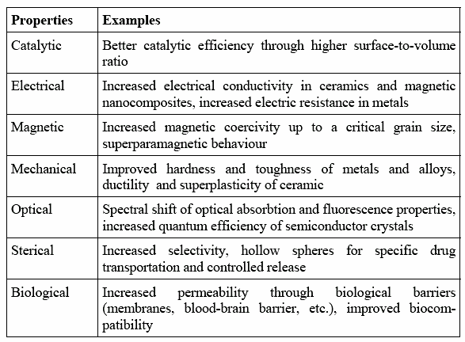
How can these properties be used to protect the environment?

Slide 14
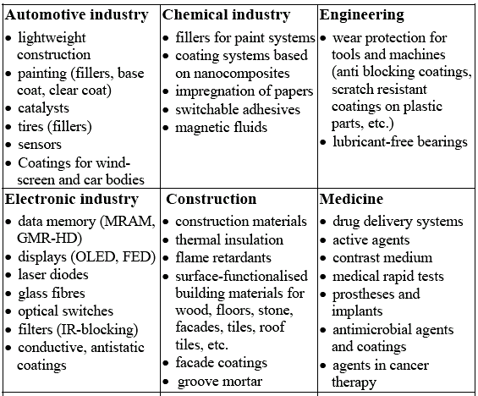
Applications of Nanotechnology
First of all one has to generate and characterise particle is in nano scale

Slide 15
Generation of Nanomaterials
We will focus on a few selected methods that are relevant to nanoscience
Top-Down Methods
Bottom-Up Methods
Other Methods (combination of both)

Slide 16
Challenges Facing Nanofabrications
There are numerous challenges facing nanofabrication and the commercialization of nanotechnology in general:
Energy, equipment and testing costs
Precision and accuracy
Connections between the nano and bulk domains
Long range order
Manufacturing standards
Health and safety
There are many more….

Slide 17
Top-Down Methods
Mechanical-energy methods
Thermal fabrication methods
High-energy and particle methods
Lithographic methods
Chemical methods
Natural processes

Slide 18
MECHANICAL METHODS
(Imparts kinetic mechanical energy to a material in order to break it down)
Ball milling
Rolling and beating
Extrusion and drawing
Mechanical machining, polishing, grinding
Mechanical cutting (e.g. a microtome)
Compaction and consolidation
Atomization

Slide 19
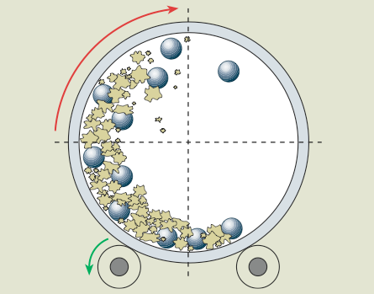
Ball Milling, Beating, Rolling etc.
Ancient peoples have been able to beat gold into thin films of 50 nm
Ball milling involves a rotating canister filled with a hard grinding medium. It operates on the principle
of mechanical attrition
where σ_{F} is the stress at which crack propagation leads to catastrophic
failure, γ is the surface energy of the material, E is the Young’s modulus and c is the length of the crack.

Slide 20
The “ball bearings” impart kinetic energy to a bulk material.
The canister begins to rotate. The bearings impart kinetic energy to the softer material. Compaction, rearrangement, elastic and plastic deformation and welding occurs. Particle fracture and fragmentation further reduce particle size.
Particles smaller than 20 nm diameter can be produced this way.
Ball to material amount is crucial
Following ball milling, the nanoparticles are compacted under pressure to form superior alloys
An advantage? Ball milling is a relatively inexpensive process.
Great disadvantage: No control of size of particle (Cost increases to separate it out the different size of particle. But till today, it is a versatile technique to produce nanomaterials

Slide 21
THERMAL METHODS
Annealing
Chill-block melt spinning->Metal is melted with RF coil and forced through nozzle on rotating drum, where it solidifies; strips formed with nanostructure
Electrohydrodynamic atomization (EHDA)
Production of monodisperse droplets; melt or liquid materials at nozzle with electric field between nozzle and surface: cone → thin jet → droplets
EDHA + pyrolysis to produce 10-nm Pt nanoparticles
Electrospinning
In electrospinning, a high voltage is applied to a polymer melt solution to induce charging. Thin layers of filaments from a bulk polymer solution are able to generate fibers of nanoscale diameter.
Liquid dynamic compaction (LDC)->Molten stream of metal is atomized by high-velocity pulses of an inert gas and the semisolidified droplets are collected on a chilled, metallic substrate.

Slide 22
Gas atomization: Molten metal is subjected to high-velocity inert gas impact that forms metal droplets.
Kinetic energy is transferred to metal, resulting in small droplets upon solidification to form powders. Powders are then compacted to form high-strength bulk materials.
Evaporation:
Evaporation of solid metal or other material samples to form thin films; usually performed under high vacuum (10^{–6} torr). Heat is produced by electrical resistance. If nanoclusters are formed during the evaporation process, it is top down. If atoms or molecules are formed during the evaporation process that recombine to form a thin layer without any chemical reaction, it is a crossover technique.
Template extrusion, Sublimation, Thermolysis / Pyrolysis, Combustion, Polymer carbonization
Atomization requires energy to overcome the cohesion energy and surface tension of the liquid.

Slide 23
Review of previous classes
Nano in Histroy
The Localized Surface Plasmon Resonance
DICHROISM
Development of nanoscience and technology
Diversity of nano field
Surface to volume atoms of Cuboctahedral system
M(K) = (1/3)*(10K³+15K²+11K+3), K = No. of shell
N_{K} =10K² + 2, Every shell contains number of shell
1. Nanotechnology in upward motion: next future of science and technology is nanotechnology
2. Constructive - Destructive interference by thin films
3. Non-Reflective Surfaces
4. Super-Hydro-Phobicity
5. Self-Cleaning
SIZE EFFECT
Quantum Effect
Colour, Melting point, Specific heat, Electrical, Magnetic properties etc.
To-Down Method of Preparation
Ball mill, Thermal, Arc discharge, Laser ablation etc.

Slide 24
HIGH-ENERGY METHODS
• Arc discharge
• Laser ablation
• Solar energy vaporization
• RF sputtering
• Ion milling
• Electron-beam evaporation
• Reactive ion etching (RIE)
• Pyrolysis
• Combustion
• High energy sonication

Slide 25
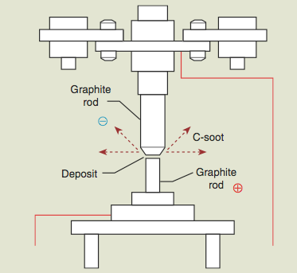
Arc Discharge
Carbon nanotubes were first deliberately produced by arc discharge on solid graphite targets.
Conditions
Potential: 20 V
Current: 50 – 100 A
He Pressure: 50 - 760 Torr
Temperature: ~ 4000 °C
Graphite rods: 1mm apart
Collection: at cathode

Slide 26
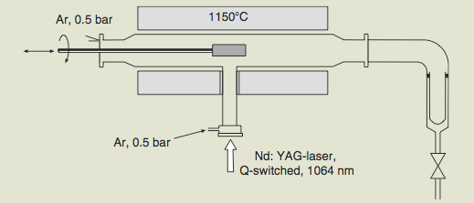
Laser Ablation
Laser ablation is a cleaner means of fabricating nanotubes than arc-discharge. Graphite targets are placed inside a quartz tube. The tube is heated to 1150°C. Vaporized carbon products are collected on a cold finger downstream of the ablation process.
Conditions:
• Temperature: 1100 - 1500 °C
• Collection: water-cooled copper coil
• Laser: IR, UV or Nd:YAG lasers
• Power: Continuous wave ~2 kW

Slide 27
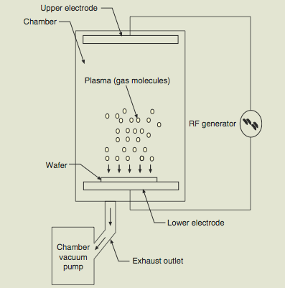
Plasma Methods
Plasma methods include RF-sputtering, plasma cleaning, ion milling and reactive ion etching.
All are characterized by a plasma formed of electrons and ionized gases.
These are considered to be physical vapor deposition methods (PVD).
In RF sputtering, a radio frequency ac field is applied across a potential to form a plasma.
The plasma, usually made of argon ions, then is accelerated onto a target material (e.g. silver). The impact is enough to “sputter” silver nanoparticles onto a
substrate (momentum exchange), thereby forming a thin film.

Slide 28
Ion milling acts in an opposite manner than RF sputtering. In this case, material is removed from a substrate. Ion milling is used to thin films for TEM analysis or to form nanofacets on a surface by removing topographically targeted sites.
Reactive ion: Sensitive materials are etched by reactive chemical species in charged plasma. Chemical change of the etched material takes place during this process. The etching process is guided by maskant materials.
Reactive ion etching is a borderline PVD-chemical process

Slide 29
CHEMICAL METHODS
• Chemical etching
Standard acid or base solution etching of silicon and other materials, usually guided by maskant materials. Materials with nanometer pore channels are produced by this method. Etching of a metal surface without substantial oxide growth results in nanofacets.
• Chemical-mechanical polishing
CMP utilizes abrasives with or without a corrosive chemical slurry.
Purpose is to thin and flatten samples. Surface roughness depends on size of abrasive. Mirror finishes with nanometer-scale roughness are produced by CMP methods.
• Electropolishing
Electropolishing is an anodic method for brightening and smoothing the surface of a metal, primarily used for aluminum.
The purpose of electropolishing is to reduce the surface roughness of a metal to nanometer scale.
Conditions are extreme: concentrated acids (or bases), elevated temperature, and elevated current.

Slide 30
Anodizing
Anodizing is considered to be a crossover method in that nanofacets are formed on a bulk aluminum surface from the top down that in turn direct the formation of an anodic oxide from the bottom up. Anodizing operates under the same principle as electropolishing except that film growth is favored instead of film dissolution. Conditions are mild in comparison: dilute polyprotic acids, low temperatures (0°C), and low current.
Combustion
Combustion is an irreversible and dynamic chemical process that is catalyzed by high-temperature flames. Trees burning in a forest fire is a top-down way to form nanoaerosols.

Slide 31
Chemical Methods
Chemical etching of silicon is a workhorse technique in
the semiconductor industry for many decades.
Si_{(s)} + 4KOH_{(aq)} → [SiO₄)⁴⁻ + 4K⁺_{(aq)} +2H_{2(g)}
Silicon is etched in an anisotropic way— i.e. that different crystal faces etch at different rates. The Si(110) surface undergoes the fastest etch rate. The etch rates of Si (110), (100) and (111) proceed at 1.5, 0.79 and 0.005 μm·min⁻¹.
Hydrofluoric acid is also used:
Si_{(s)} + 6HF_{(aq)} → [SiF₆)²⁻ + 4H⁺_{(aq)} +2H_{2(g)}

Slide 32
Chemical Methods: Anodizing
Anodizing is a splendid means of forming a nanostructured material from bulk aluminum metal.
Anode Reaction: 2Alº_{(s)} → 2Al³⁺(aq) + 6e-
Oxide-Electrolyte Interface: 2Al³⁺_{(aq)} + 3H₂O → Al₂O_{3(s)} + 6H⁺_{(aq)}
Cathode Reaction: 6H⁺_{(aq)} + 6e⁻ → 3H_{2(g)}
-------------------------------------------------------------------------------------------------------------------
Overall Reaction: 2Alº_{(s)} + 3H₂O → Al₂O₃ + 3H_{2(g)}
Starting with pure aluminum in an acid solution (sulfuric, oxalic or phosphoric acids usually) and applying a potential, scallops are formed in the top layer of the Al metal.

Slide 33
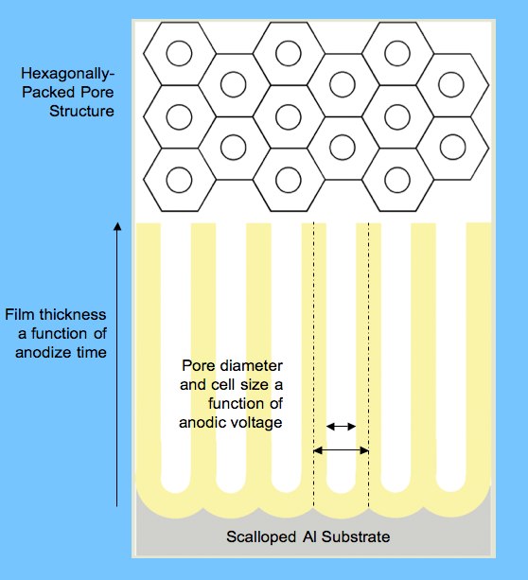
The diameter of the scallops, and therefore the size of the porous cells, is directly proportional to the applied voltage. The diameter in nm of the pore channels follows:
d_{pore} ∝ 1.4 V
Porous anodic templates are chemically resistant (except to
strong acids or bases), optically
clear, thermally stable (to 1000
°C depending on the electrolyte)
and physical rather durable
(although it is a ceramic). In its
post anodize stage, the barrier
layer is still conductive and
metals can be plated within the
pores.

Slide 34
Review of previous classes
Nano in Histroy
The Localized Surface Plasmon Resonance
DICHROISM
Development of nanoscience and technology
Diversity of nano field
Surface to volume atoms of Cuboctahedral system
M(K) = (1/3)*(10K³+15K²+11K+3), K = No. of shell
N_{K} =10K² + 2, Every shell contains number of shell
1. Nanotechnology in upward motion: next future of science and technology is nanotechnology
2. Constructive - Destructive interference by thin films
3. Non-Reflective Surfaces
4. Super-Hydro-Phobicity
5. Self-Cleaning
SIZE EFFECT
Quantum Effect
Colour, Melting point, Specific heat, Electrical, Magnetic properties etc.
To-Down Method of Preparation
Ball mill, Thermal, Arc discharge, Laser ablation etc.
LITHOGRAPHIC METHOD

Slide 35
LITHOGRAPHIC METHODS
Lithography is the workhorse of the computer chip industry. It is the most common top-down manufacturing process and it is one nano manufacturing technique that is widespread.
Photolithography
Immersion lithography
Deep ultraviolet lithography (DUV)
Extreme ultraviolet lithography (EUVL)
X-ray lithography (XRL)
Electron-beam lithography
Electron beam writing (EBW)
Electron beam projection lithography (EPL)
Focused ion beam lithography (FIBL)
Microcontact printing methods
Nano imprint lithography (NIL)
Nanosphere lithography (NSL)
Scanning AFM nano-stencil
Scanning probe nano-lithographies

Slide 36
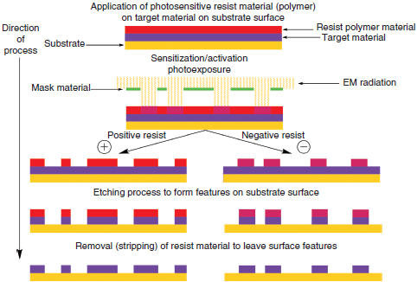
Photolithography

Slide 37
A target material is first applied to the surface of a silicon substrate. Polymeric resist layer is then applied by spin coating. An energy beam, usually in the visible to ultraviolet wavelength range, is shined through a mask that contains a predetermined pattern. Regions exposed to the EM radiation are sensitized (positive resist) or protected (negative) to the subsequent etch step. Following etching, the resist is removed, transferring the pattern inscribed by the mask to the target material. Lithography is a rather expensive process that requires clean room conditions, high-vacuum conditions, and otherwise expensive equipment.

Slide 38
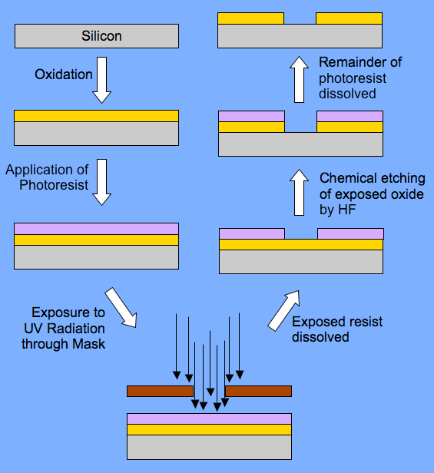
Pattern Transfer:
The product can be “positive” or “negative” of the mask depending on what part of the resist is
Dissolved. Overall, a negative or
positive replica of the mask pattern is reproduced. For positive resists, exposure toUV light makes the resist more soluble to dissolution.
UV exposure to negative resists cause the resist material to polymerize and therefore, render it less soluble in the dissolving medium

Slide 39
There are three general kinds of photo lithography:
1. Contact printing— Mask lies on the top of the resist (there is no wafer-mask gap) requires no magnification but resolution is limited (~500nm). The mask degrades in this configuration resulting in loss of planarity. Radiation interacts with the sample as a square wave with limited or no diffraction. The near field (or fresnel diffraction limit), appropriate for proximity printing, and resolution given by
2. Proximity printing involves no contact with the resist by the mask— held 20-50 μm from resist. Resolution not as good as for contact printing due to Fresnel near
field diffraction of light made better by using shorter wavelengths. Limit defined by:
Κ is a constnat close to 1, λ is the wavelength of imprinting radiation, d_{g} is the mask-to wafer distance
3. Projection printing uses a large gap between mask and resist (Fresnel diffraction not a problem). Resolution governed by Rayleigh criterion:
N. A. ~ numerical apperature = nsinθ, n is refractive index, θ is the half angle of the cone of light that can enter or exit the lens

Slide 40
Ernst Abbe: 1840 - 1905
The fundamental nature of light poses limits on the detail that can be resolved. Abbe (1893) showed that the smallest resolvable distance is about 1/2 the wavelength of light used. Thus, 1/2 the wavelength of the radiation used is the ultimate resolving power of any instrument.
John William Strutt (Lord Rayleigh): 1842 - 1919
The Rayleigh criterion defines the resolution (R) of light microscope as:
R=d/2=0.61λ/nsinθ
where λ is the wavelength of the radiation,
n is the refractive index of the view medium and,
θ is the semi-angle of collection of the magnifying lens.
X-ray: Cu kα: λ=0.154 nm, Electron: 200 kV, 0.00251 nm
Due to the limitations of the values α, λ , and n, the resolution limit of a light microscope using visible light is about 200 nm. The shortest wavelength of visible light is blue (λ = 450nm), θ for the best lens is about 70° (sin θ = 0.94), and the typical high resolution lenses are oil immersion lenses (n = 1.56): R=187 nm
(Numerical aperature=N.A. = nsinθ)

Slide 41
Review of previous classes
Nano in Histroy
The Localized Surface Plasmon Resonance
DICHROISM
Development of nanoscience and technology
Diversity of nano field
Surface to volume atoms of Cuboctahedral system
M(K) = (1/3)*(10K³+15K²+11K+3), K = No. of shell
N_{K} =10K² + 2, Every shell contains number of shell
1. Nanotechnology in upward motion: next future of science and technology is nanotechnology
2. Constructive - Destructive interference by thin films
3. Non-Reflective Surfaces
4. Super-Hydro-Phobicity
5. Self-Cleaning
SIZE EFFECT
Quantum Effect
Colour, Melting point, Specific heat, Electrical, Magnetic properties etc.
To-Down Method of Preparation
Ball mill, Thermal, Arc discharge, Laser ablation etc.
LITHOGRAPHIC METHOD
Bottom-UP method

Slide 42
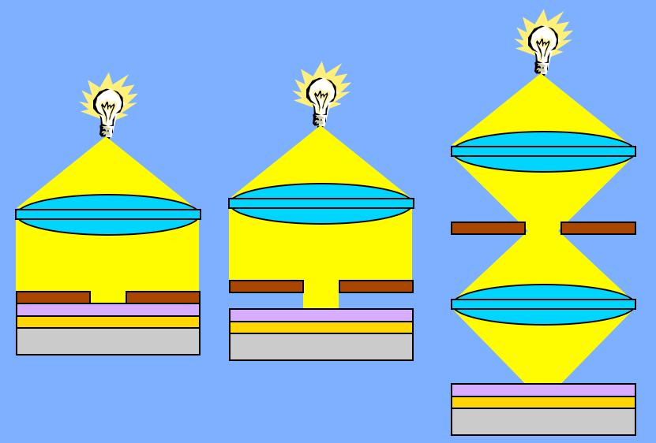
Contact
Proximity
Projection

Slide 43
What is the resolution of a projection lithograph system that employs 500 nm radiation. Assume k = 0.35 and N.A. is 0.8. What can you do to improve the
resolution?
W = (0.35) ⋅ 500 nm/0.8 = 219 nm
Resolution can be improved by reducing the wavelength or Increasing the numerical aperture. If possible, increasing the Refractive index of the medium would help to better the resolution (recall that N.A. ∝ n sin θ)

Slide 44
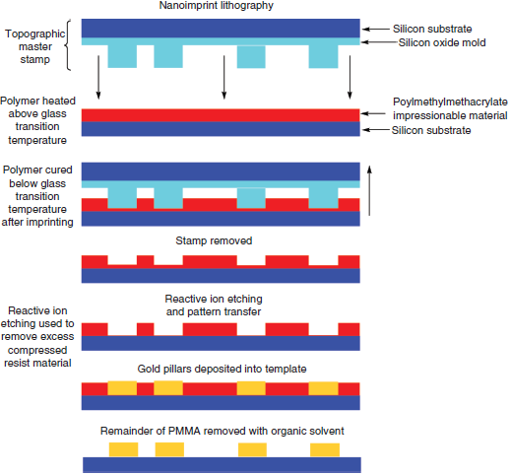
NANO-IMPRINT LITHOGRAPHIC METHODS
Nano-imprint lithography (NIL) was invented in the mid 1990s by Stephen Chou of Princeton University. NIL is a method that is capable of generating features with nanoscale resolution with high throughput. A stamp (top), made by an electron beam lithographic method, is pressed into a soft polymeric material at its glass transition temperature. The film is hardened before the stamp is removed. Anisotropic etching by RIE process removes excess polymer. Metallic pillars are fabricated in the nanofeatures formed by NIL.

Slide 45
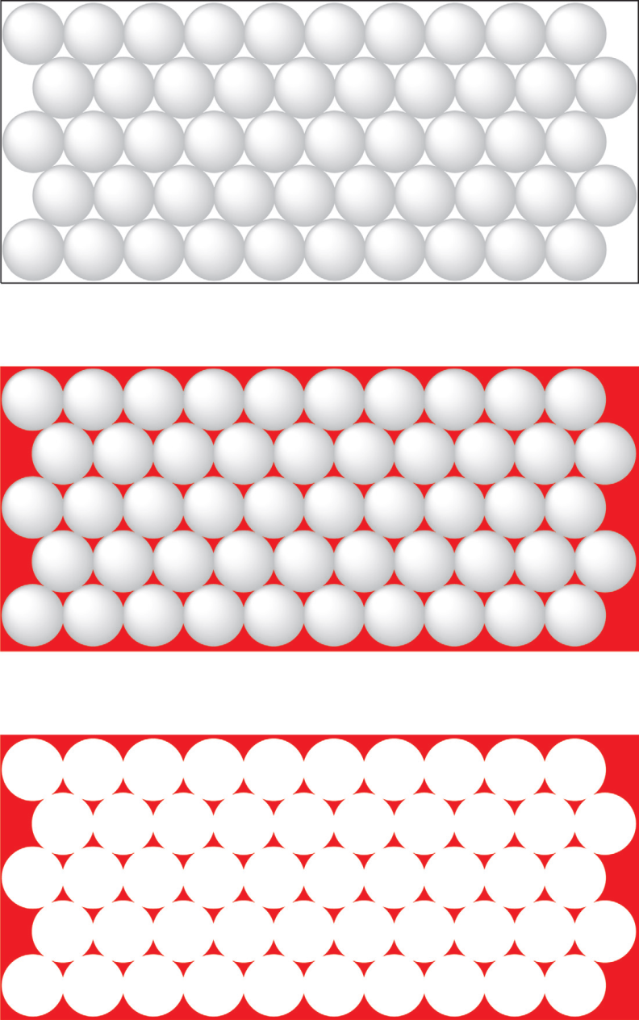
Nanosphere lithography (NSL), like NIL, is another ingenious low-cost, high- throughput method to form nanomaterials and nanoparticle arrays. One simple method utilizes latex
spheres that are close packed in a two-dimensional array. Deposition of metal between spheres, the interstitial spaces, forms star-shaped patterns of tetrahedrally formed nanostructured
materials. RIE etching, depending on the type of active molecule, is able to reduce
the size of the spheres (thereby creating wider gaps among the spherical matrix elements, or etch) in an anisotropic manner, the substrate under the spaces to form pore channels.

Slide 46
Review of previous classes
Nano in Histroy
The Localized Surface Plasmon Resonance
DICHROISM
Development of nanoscience and technology
Diversity of nano field
Surface to volume atoms of Cuboctahedral system
M(K) = (1/3)*(10K³+15K²+11K+3), K = No. of shell
N_{K} =10K² + 2, Every shell contains number of shell
1. Nanotechnology in upward motion: next future of science and technology is nanotechnology
2. Constructive - Destructive interference by thin films
3. Non-Reflective Surfaces
4. Super-Hydro-Phobicity
5. Self-Cleaning
SIZE EFFECT
Quantum Effect
Colour, Melting point, Specific heat, Electrical, Magnetic properties etc.
To-Down Method of Preparation
Ball mill, Thermal, Arc discharge, Laser ablation etc.
LITHOGRAPHIC METHOD
Bottom-UP method

Slide 47
BOTTOM-UP METHODS
Gas-phase bottom-up methods
Non-biological liquid-phase bottom-up methods
Bottom-up lithographic methods
Bottom-up natural (biological and inorganic) methods
d = distance between molecules in a gas
V= volume, N = number of molecules,
In an ideal gas at STP,
V = 22.4 lt, N = Avogadro’s no. d = 3.34nm

Slide 48
BOTTOM-UP GAS PHASE METHODS
Chemical vapor deposition (CVD)
Atomic layer deposition
Combustion
Thermolysis – pyrolysis
Metal oxide chemical vapor deposition (MOCVD)
Organometallic vapor phase epitaxy (OMPVE)
Molecular beam epitaxy (MBE)
Ion implantation
Gas phase condensation, thermolysis
Gas deposition on solid templates
Evaporation
Sublimation

Slide 49
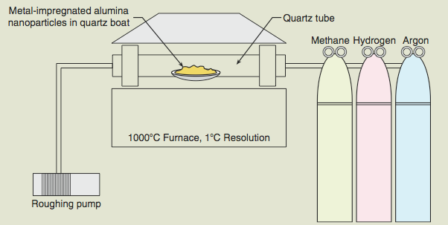
Chemical Vapor Deposition (CVD)
CVD involves the formation of nanomaterials from the gas phase at Elevated temperatures— usually onto a solid substrate or catalyst. Carbon nanotubes are formed by CVD processes.
Chemical vapor deposition, especially in the case of carbon nanotubes, is yet another low cost, “low-tech” method to form nanomaterials. A carbon source gas (usually methane, CO, acetylene, propylene, or ethylene) is introduced into a chamber (the quartz tube pictured) under reducing conditions. Upon contact with Co, Fe, or Ni catalyst particles, the gases decompose into C and H atoms. Nanotubes nucleate on the catalyst particle and grows out from the particle by either the tip-growth or base-growth mechanism. Typical CVD conditions use 10% methane, 5% hydrogen, 85% argon carrier gas at 700°C, and atmospheric pressure.

Slide 50
CVD involves the formation of nanomaterials from the gas phase at elevated temperatures— usually onto a solid substrate or catalyst.
Carbon nanotubes are formed by CVD processes.
The process involves:
– Gas-phase carbon source (CH₄, C₂H₄, C₂H₂, etc.)
– Nanometal catalysts (Fe, Co, Ni + Mo accelerator)
– Fumed alumina support materials (high surface area)
– Temperatures in the range of 400 to 1000 °C
– Hydrogen gas and argon carrier gas
Carbon nanotubes formed by this process require extensive purification to remove metal, alumina and sooty carbon byproducts.

Slide 51
There are different types of CVD
1. Metal Oxide CVD (MOCVD): Used H₂ as a carrier gas. Group- III metal –organic compunds and group – V hydrides
2. Plasma Enhanced CVD (PECVD): The plasma is created by radio frequency or direct current discharge between electrodes. SiO₂ can be formed. Silicon nitride thin films.
3. Low pressure CVD (LPCVD) or Liquid phase CVD: (T=650⁰C):Another gas phosphine or arsine

Slide 52
ATOMIC LAYER DEPOSITION (ALD)
1974-> Finland , Tuoma Suntala, Improve the quality of ZnS films used in electroluminesence displays.
ALD is the process of fabricating uniform conformal films through the cyclic deposition of self-terminating surface half –reactions that allows for thickness control at the level of the atomic layer.
Surface activation -> Injection of A -> Purge -> Injection of B -> purge-> injection of A - > purge - > Injection of B - > purge -> ….->termination

Slide 53
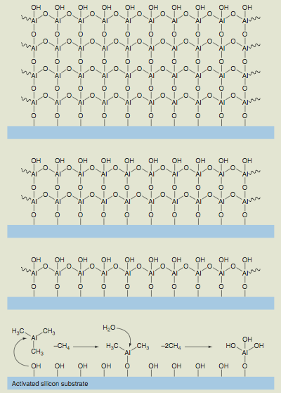
Atomic Layer Deposition (ALD)
ALD is the process of fabricating
uniform conformal films through the
cyclic deposition of self-terminating
surface half-reactions. ALD allows
for monolayer deposition, and, as a
result, there is good control over
layer thickness.
• Surface activated with OH groups
• Al(CH₃)₃ replaces H on OH
• Process until saturation
• Water removes all methyl groups
• Process repeats
• Thickness controlled by cycles
Surface activation -> Injection of A -> Purge -> Injection of B -> purge-> injection of A - > purge - > Injection of B - > purge -> ….->termination

Slide 54
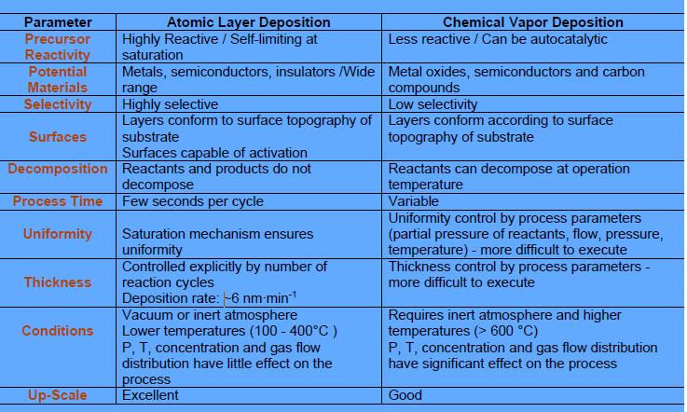

Slide 55
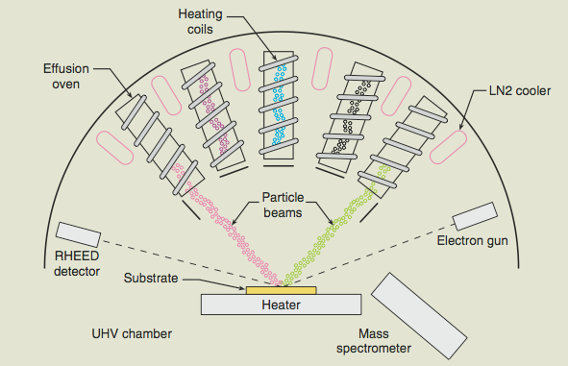
Molecular Beam Epitaxy (MBE)
The term epitaxy implies lateral growth on a surface. Epitaxy is the evaporation of one or more elemental or molecular species onto a heated substrate in high vacuum
One potential issue with epitaxial layers is the potential mismatch between crystal types. This is a potential source of strain within the epitaxial layer.
Homo epitaxi
Heteroepitaxi
One criterion for MBE operation is that the mean free path (λ) of atoms, molecules or clusters be larger than the geometric dimention of the chamber.
The time it takes for surface diffusion incorporation be less than the time required to deposite a monolayer

Slide 56
Ion Implantation
In this procedure, ions of one material can be implanted into the matrix of another solid material. The implanted ions may chemically alter the nature of the solid or it may alter the crystal structure.
Doping in semiconductors is accomplished by accelerating boron, phosphorus or arsenic ions at energies ranging from 10 to 500 keV to form charge carriers (electrons or holes depending on the type of semiconductor p-type or n-type).
ZnO nanoparticles were fabricated in SiO₂ by ion implantation in combination with thermal oxidation (Zn+ ions @ 60 keV yielding 10¹⁷ ions·cm⁻² followed by oxidation at 700 °C for 1 h. ZnO nanoparticles 5-10 nm in diameter within 80 nm of the surface of the silica).

Slide 57
Thermal Decomposition
Solid Si nanoparticles can be formed from thermal decomposition of silane gas:
SiH₄(g) → Si(s) + 2H₂(g)
Ferrocene, mentioned earlier, also follows this pathway:
Fe(C₂H₅)₂(g) → Fe(s) + (C₂H₅)₂(g)+ C decay products
The thermal decomposition of zinc acetate led to the formation of nanowires, nanoparticles and nanowalls of ZnO on Si at 200-250 °C substrate temperature. The diameters ranged from 30 to 100 nm. The nanowall thickness was 20 nm.

Slide 58
BOTTOM-UP LIQUID PHASE METHODS
Molecular self-assembly
• Supramolecular chemistry
• Nucleation and sol-gel processes
• Reduction of metal salts
• Single-crystal growth
• Electrodeposition / electroplating
• Anodizing
• Molten salt solution electrolysis
• Solid template synthesis
• Liquid template synthesis
• Super-critical fluid expansion

Slide 59
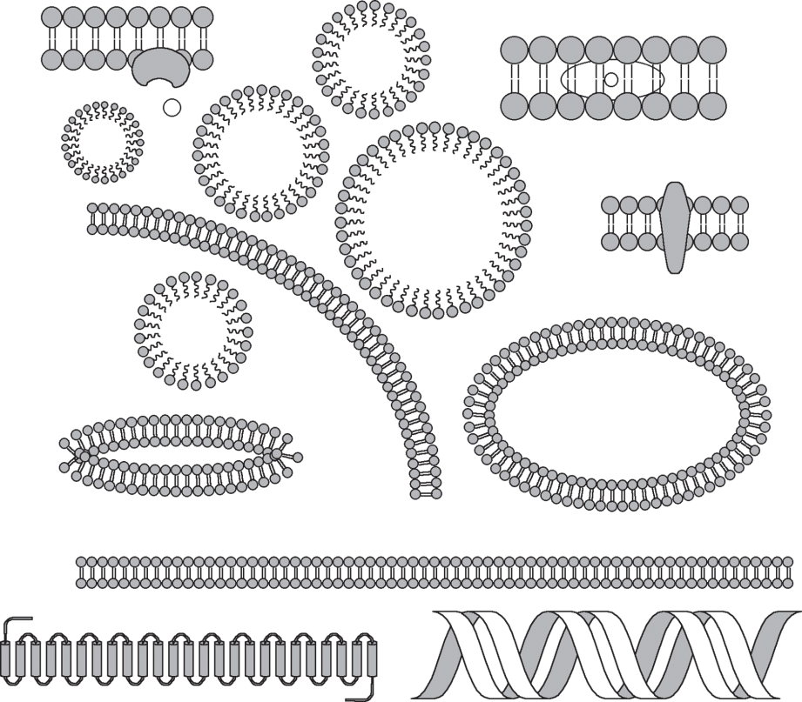
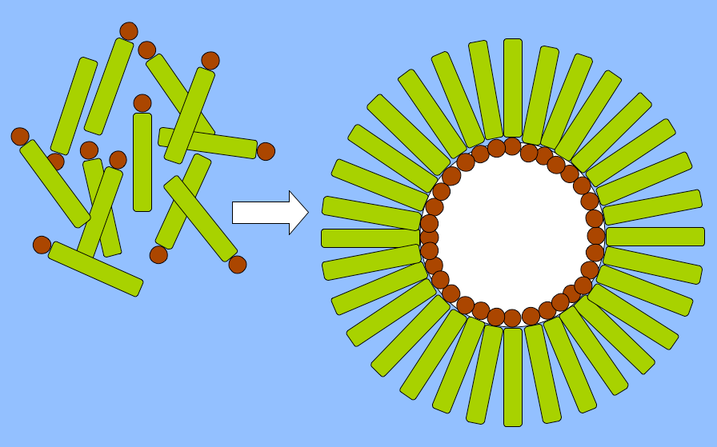
Molecular Self-Assembly
Self-assembly is a fast expanding technique that is expected to make significant contributions to bottom-up manufacturing of nanomaterials. Various types of micelles are shown in the figure. Depending on solution conditions, micelles (the spherical structures depicted) or bilayers are commonly formed. Micelles are made of molecules called amphiphiles: single molecules that have both a polar and a nonpolar chemical group. In order for self assembly techniques to become dominant, problems with self-assembly methods, including lack of long-range order and structural integrity, need to be overcome.
Hydrophobic
Tail Group
Hydrophilic
Core
Hydrophilic
Head Group

Slide 60
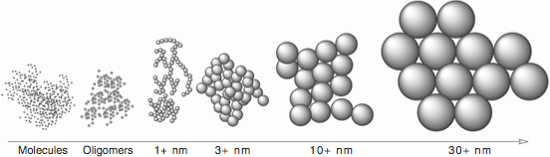
Nucleation and Sol-Gel Processes
Sol–gel synthesis is an old technology that has incredible potential for nanomanufacturing. Starting from the absolute bottom with molecules and via the process of nucleation and Ostwald ripening, larger and larger particles are grown until the reaction is terminated. Following a sintering process, an array of close-packed spherical particles can be used to form aerogels or xerogels or act as a template to form other nanomaterials.

Slide 61
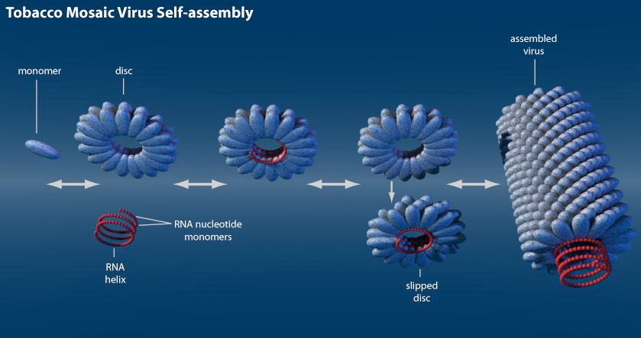
Electroplating and Electro less Deposition
Biological Bottom-Up Febrication method
Biotemplate Synthesis of 3-nm Ni and Co Nanowires
The central channel of the tobacco mosaic virus (TMV) was used as a template to electrolessly deposit Ni and Co nanowires with diameter of 3 nm with lengths in the micrometer range!!!
TMV is a tube shaped
virus made of 6390 nucleotide bases and 2130 identical wedge shaped coat proteins. OD = 18nm; ID = 4 nm;
Length = 300 nm

